Slide 1
ENPM 691 Secure Programming in C
Motivation for Secure Programming (Lecture: 1)
Dr. Dharmalingam Ganesan

Slide 2
Secure Programming
Secure programming is the study of insecure coding practices, and how these may be exploited.
Insecure designs: the code is correctly implemented but the resulting software contains a vulnerability.
Secure designs require an understanding of functional and non-functional software requirements.
ENPM 691 is meant to teach industrial strength, secure coding practices.

Slide 3
Agenda
Software Security
W32.Blaster.Worm
Gauging the Threat
Security Concepts
Software Defects
Summary

Slide 4
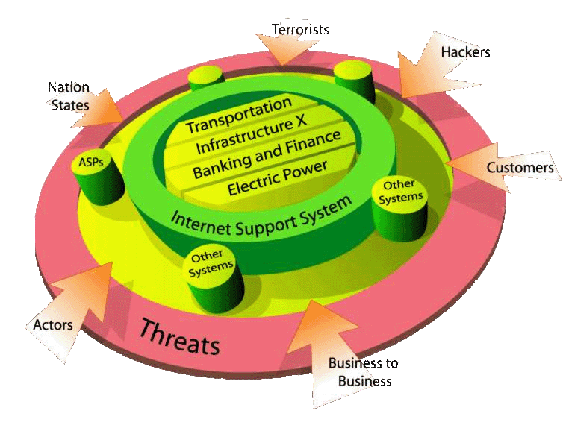
Why Software Security?
Developed nations’ economies and defense depend, in large part, on the reliable execution of software.
Software is ubiquitous, affecting all aspects of our personal and professional lives.
Software vulnerabilities are equally ubiquitous, jeopardizing:
Personal identities
Intellectual property
Consumer trust
Business services, operations, & continuity
Critical infrastructures & government
Notes:
Reference Hal Tipton’s presentation.

Slide 5
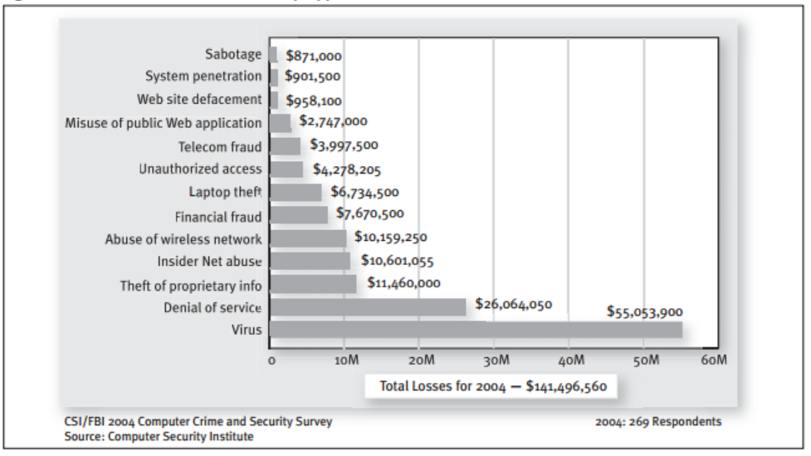
Dollar Amount of Losses by Type?
Notes:
See https://gocsi.com/sites/default/files/uploads/FBI2004.pdf

Slide 6
So What Is Software Security?
Not the same as security software
Firewalls, intrusion detection, encryption
Protecting the environment within which the software operates
Engineering software so that it continues to function under attack
The ability of software to recognize, resist, tolerate, and recover from events that threaten it
Goal: Better, defect-free software that can function more robustly in its operational production environment

Slide 7
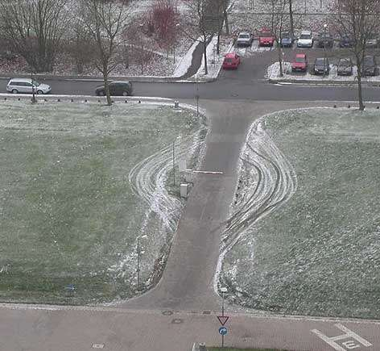
Application Security
Notes:
Attackers have been learning how to exploit software for several decades; the same is not true for software engineers

Slide 8
Sources of Software Insecurity 1
Complexity, inadequacy, and change
Incorrect or changing assumptions (capabilities, inputs, outputs)
Flawed specifications & designs
Poor implementation of software interfaces (input validation, error & exception handling)
Inadequate knowledge of secure coding practices

Slide 9
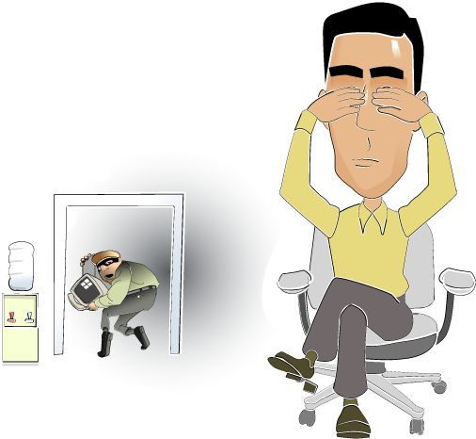
Sources of Software Insecurity 2
Unintended, unexpected interactions
with other components
with the software’s execution environment
Absent or minimal consideration of security during all life cycle phases
Not thinking like an attacker

Slide 10
Most Vulnerabilities caused by Programming Errors
64% of the vulnerabilities in National Vulnerability Database are due to programming errors
51% of those due to classic errors like buffer overflows, cross-site-scripting, injection flaws
Cross-site scripting, SQL injection at top of the statistics (CVE, Bugtraq) in 2006
“We wouldn't need so much network security if we didn't have such bad software security”
--Bruce Schneier

Slide 11
CWE/SANS Top 25 Most Dangerous Software Errors
Rank | Score | ID | Name
[1] | 93.8 | CWE-89 | Improper Neutralization of Special Elements used in an SQL Command ('SQL Injection')
[2] | 83.3 | CWE-78 | Improper Neutralization of Special Elements used in an OS Command ('OS Command Injection')
[3] | 79.0 | CWE-120 | Buffer Copy without Checking Size of Input ('Classic Buffer Overflow')
[4] | 77.7 | CWE-79 | Improper Neutralization of Input During Web Page Generation ('Cross-site Scripting')
[5] | 76.9 | CWE-306 | Missing Authentication for Critical Function
[6] | 76.8 | CWE-862 | Missing Authorization
[7] | 75.0 | CWE-798 | Use of Hard-coded Credentials
[8] | 75.0 | CWE-311 | Missing Encryption of Sensitive Data
[9] | 74.0 | CWE-434 | Unrestricted Upload of File with Dangerous Type
[10] | 73.8 | CWE-807 | Reliance on Untrusted Inputs in a Security Decision
[11] | 73.1 | CWE-250 | Execution with Unnecessary Privileges
[12] | 70.1 | CWE-352 | Cross-Site Request Forgery (CSRF)

Slide 12
CWE/SANS Top 25 Most Dangerous Software Errors
Rank | Score | ID | Name
[13] | 69.3 | CWE-22 | Improper Limitation of a Pathname to a Restricted Directory ('Path Traversal')
[14] | 68.5 | CWE-494 | Download of Code Without Integrity Check
[15] | 67.8 | CWE-863 | Incorrect Authorization
[16] | 66.0 | CWE-829 | Inclusion of Functionality from Untrusted Control Sphere
[17] | 65.5 | CWE-732 | Incorrect Permission Assignment for Critical Resource
[18] | 64.6 | CWE-676 | Use of Potentially Dangerous Function
[19] | 64.1 | CWE-327 | Use of a Broken or Risky Cryptographic Algorithm
[20] | 62.4 | CWE-131 | Incorrect Calculation of Buffer Size
[21] | 61.5 | CWE-307 | Improper Restriction of Excessive Authentication Attempts
[22] | 61.1 | CWE-601 | URL Redirection to Untrusted Site ('Open Redirect')
[23] | 61.0 | CWE-134 | Uncontrolled Format String
[24] | 60.3 | CWE-190 | Integer Overflow or Wraparound
[25] | 59.9 | CWE-759 | Use of a One-Way Hash without a Salt

Slide 13
Agenda
Software Security
W32.Blaster.Worm
Gauging the Threat
Security Concepts
Software Defects
Summary

Slide 14
W32.Blaster.Worm
Infected unpatched systems connected to the Internet without user involvement.
At least eight million Windows systems have been infected by this worm [Lemos 04].
Exploits a vulnerability in the DCOM RPC interface of Windows.
Propagates via TCP/IP.
Economic damage estimated to be at least $525 million.

Slide 15
Flawed Logic Exploited by Blaster
HRESULT GetServerPath(
WCHAR *pwszPath, WCHAR **pwszServerPath ) {
WCHAR *pwszFinalPath = pwszPath;
WCHAR wszMachineName[MAX_COMPUTERNAME_LENGTH_FQDN+1];
hr = GetMachineName(pwszPath, wszMachineName);
*pwszServerPath = pwszFinalPath;
}
HRESULT GetMachineName(
WCHAR *pwszPath,
WCHAR wszMachineName[MAX_COMPUTERNAME_LENGTH_FQDN+1]) {
pwszServerName = wszMachineName;
LPWSTR pwszTemp = pwszPath + 2;
while ( *pwszTemp != L'\\' )
*pwszServerName++ = *pwszTemp++;
...
}
Unbounded string copy

Slide 16
Agenda
Software Security
W32.Blaster.Worm
Gauging the Threat
Security Concepts
Software Defects
Summary

Slide 17
Gauging the Threat
The risk of producing insecure software systems can be evaluated by
Looking at historic risk
The potential for future attacks
Historic risk can be measured by
Looking at the type
Cost of perpetrated crimes
The potential for future attacks can be partially gauged by
Evaluating emerging threats
The security of existing software systems

Slide 18
Who is the Threat?
Threat is a person, group, organization, or foreign power that has been the source of past attacks or may be the source of future attacks.
Threats include
Hackers
Insiders
Criminals
Competitive Intelligence Professionals
Terrorists
Information Warriors

Slide 19
Hackers
Motivated by curiosity and peer recognition from other hackers.
Write programs that expose vulnerabilities in computer software.

Slide 20
Insiders
The threat comes from a current or former employee or contractor of an organization.
Has legitimate access to the information that was compromised.
Do not need to be technically sophisticated to carry out attacks.
Technically sophisticated insiders can launch attacks with immediate and widespread impact.
Technical insiders can cover their tracks.

Slide 21
Criminals
Common crimes include
auction fraud
single largest category of Internet related complaints in the FTC's Consumer Sentinel database
more than 51,000 auction complaints logged in 2002
identity theft
Phishing attacks
use spoofed e-mails and fraudulent web sites.
designed to fool recipients into divulging
personal financial data
credit card numbers
account user names and passwords
social security numbers.

Slide 22
Competitive Intelligence Professionals
Corporate spies or “competitive intelligence professionals”.
Have their own professional association—the Society for Competitive Intelligence Professionals (SCIP).
May work from inside a target organization, obtaining employment to steal and market trade secrets.

Slide 23
Terrorists
Cyber-terrorism can be defined as unlawful attacks or threats of attack against computers, networks, and other information systems to intimidate or coerce a government or its people to further a political or social objective [Denning 00].

Slide 24
Information Warriors
8 nations have developed cyber-warfare capabilities comparable to that of the United States.
More than 100 countries are trying to develop them.
23 nations have targeted U.S. systems.

Slide 25
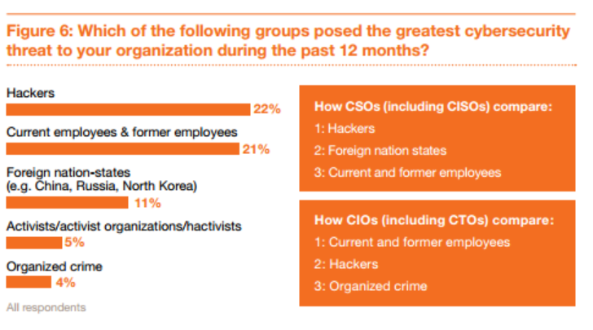
Groups posed the threat?
Source: Key findings from the 2013 US State of Cybercrime Survey

Slide 26
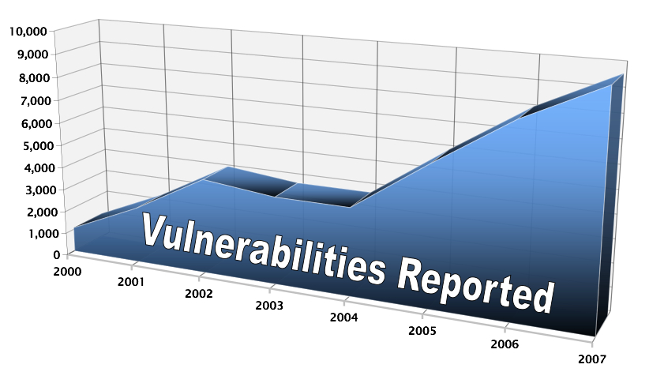
Increasing Vulnerabilities
Reacting to vulnerabilities in existing systems is not working
Vulnerabilities reported to SEI CERT.

Slide 27
Agenda
Software Security
W32.Blaster.Worm
Gauging the Threat
Security Concepts
Software Defects
Summary

Slide 28
Computer Security Definition
Computer security is preventing attackers from achieving objectives through unauthorized access or unauthorized use of computers and networks [Howard 97].

Slide 29
Security Concepts
Security
policy
System
administrator
Network
administrator
Programmer
System
integrator
applied
to
Source
code
composed of
Software
component
composed of
Program
composed of
Computer
System
composed of
Network
may
contain
may
contain
may
contain
may
possess
may
possess
Security flaw
can lead to
Vulnerability
resolved
by
addressed
by
attacked
by
Vulnerability
analyst
Security
analyst
Mitigation
Exploit
Security researcher
Attacker

Slide 30
Programmer
A programmer is concerned with properties of a program such as correctness, performance, and security.
Security
policy
Programmer
System
integrator
System
administrator
Network
administrator
applied
to
Source
code
composed of
Software
component
composed of
Program
composed of
Computer
System
composed of
Network
may
contain
may
contain
may
contain
may
possess
may
possess
Security flaw
can lead to
Vulnerability
resolved
by
addressed
by
attacked
by
Vulnerability
analyst
Security
analyst
Mitigation
Exploit
Security researcher
Attacker

Slide 31
System Integrator
A system integrator is responsible for integrating new and existing software components to create systems that satisfy a particular set of customer requirements.
Security
policy
Programmer
System
integrator
System
administrator
Network
administrator
applied
to
Source
code
composed of
Software
component
composed of
Program
composed of
Computer
System
composed of
Network
may
contain
may
contain
may
contain
may
possess
may
possess
Security flaw
can lead to
Vulnerability
resolved
by
addressed
by
attacked
by
Vulnerability
analyst
Security
analyst
Mitigation
Exploit
Security researcher
Attacker

Slide 32
System Administrators
System administrators are responsible for managing and securing one or more systems including
installing and removing software
installing patches
managing system privileges
Security
policy
System
administrator
Network
administrator
Programmer
System
integrator
applied
to
Source
code
composed of
Software
component
composed of
Program
composed of
Computer
System
composed of
Network
may
contain
may
contain
may
contain
may
possess
may
possess
Security flaw
can lead to
Vulnerability
resolved
by
addressed
by
attacked
by
Vulnerability
analyst
Security
analyst
Mitigation
Exploit
Security researcher
Attacker

Slide 33
Network Administrators
Network administrators are responsible for managing the secure operations of networks.
Security
policy
System
administrator
Network
administrator
Programmer
System
integrator
applied
to
Source
code
composed of
Software
component
composed of
Program
composed of
Computer
System
composed of
Network
may
contain
may
contain
may
contain
may
possess
may
possess
Security flaw
can lead to
Vulnerability
resolved
by
addressed
by
attacked
by
Vulnerability
analyst
Security
analyst
Mitigation
Exploit
Security researcher
Attacker

Slide 34
Security Analyst
A security analyst is concerned with properties of security flaws and how to identify them.
Security
policy
Programmer
System
integrator
System
administrator
Network
administrator
applied
to
Source
code
composed of
Software
component
composed of
Program
composed of
Computer
System
composed of
Network
may
contain
may
contain
may
contain
may
possess
may
possess
Security flaw
can lead to
Vulnerability
resolved
by
addressed
by
attacked
by
Vulnerability
analyst
Security
analyst
Mitigation
Exploit
Security researcher
Attacker

Slide 35
Vulnerability Analyst
A vulnerability analyst is concerned with analyzing vulnerabilities in existing and deployed programs.
Security
policy
Programmer
System
integrator
System
administrator
Network
administrator
applied
to
Source
code
composed of
Software
component
composed of
Program
composed of
Computer
System
composed of
Network
may
contain
may
contain
may
contain
may
possess
may
possess
Security flaw
can lead to
Vulnerability
resolved
by
addressed
by
attacked
by
Vulnerability
analyst
Security
analyst
Mitigation
Exploit
Security researcher
Attacker

Slide 36
Security Researcher
A security researcher develops mitigation strategies and solutions and who may be employed in industry, academia, or government.
Security
policy
Programmer
System
integrator
System
administrator
Network
administrator
applied
to
Source
code
composed of
Software
component
composed of
Program
composed of
Computer
System
composed of
Network
may
contain
may
contain
may
contain
may
possess
may
possess
Security flaw
can lead to
Vulnerability
resolved
by
addressed
by
attacked
by
Vulnerability
analyst
Security
analyst
Mitigation
Exploit
Security researcher
Attacker

Slide 37
Attacker
The attacker is a malicious actor who exploits vulnerabilities to achieve an objective.
objectives vary depending on the threat.
also referred to as
the adversary
malicious user
hacker
other alias

Slide 38
Security Policy
A Security Policy is a set of rules and practices that specify or regulate how a system or organization provides security services to protect sensitive and critical system resources
[Internet Society 00].

Slide 39
Security Flaws
A software defect is the encoding of a human error into the software, including omissions.
Security flaws include software defects that pose a potential security risk.
Eliminating software defects often eliminates security flaws.

Slide 40
Vulnerabilities
A vulnerability is a set of conditions that allows an attacker to violate an explicit or implicit security policy.
Not all security flaws lead to vulnerabilities.

Slide 41
Exploits 1
An exploit is program or technique that takes advantage of a security vulnerability to violate an explicit or implicit security policy.
Vulnerabilities in software are subject to exploitation.
Exploits can take many form including
worms
viruses
trojans

Slide 42
Proof-of-Concept Exploits
May be developed to prove the existence of a vulnerability.
Are beneficial when properly managed.
In the wrong hands can be quickly transformed into a worm or virus or used in an attack.

Slide 43
Mitigations
Mitigations are methods, techniques, processes, tools, or runtime libraries that can prevent or limit exploits against vulnerabilities.
At the source code level, a mitigation may involve replacing an unbounded string copy operation with a bounded one.
At a system or network level, a mitigation may involve turning off a port or filtering traffic to prevent an attacker from accessing a vulnerability.

Slide 44
Agenda
Software Security
W32.Blaster.Worm
Gauging the Threat
Security Concepts
Software Defects
Summary

Slide 45
Sample issues we will cover in detail in ENPM 691

Slide 46
Format String – User Input with %s
void main(int argc, char** argv)
{
char* userPassword = “This is a user password\n”;
char* adminPassword = “This is an admin password\n”;
printf(argv[1]);
}
./main “%s”
This is a user password

Slide 47
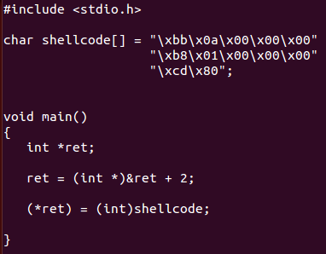
Injecting a shellcode
Machine code of exit(10)
&ret + 2 points to the return address of caller
./main
echo $?
Output: 10
main is called by libc_main
we tricked the return to our shellcode

Slide 48
Smashing the stack
void deadCode()
{
printf(“I’m alive!”);
exit(0);
}
void getData()
{
char buffer[8];
gets(buffer);
puts(buffer);
}
Can we activate the deadCode by smashing the stack?

Slide 49
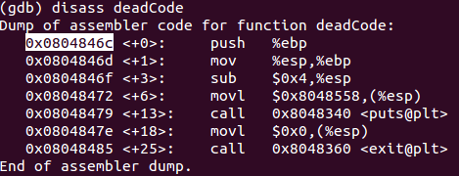
Smashing the stack…
First 8 bytes for our input buffer
Next 4 bytes to override the ebp register
Last 4 bytes point to the deadCode function

Slide 50
Inadequate File Name Validation
Many privileged applications construct path names dynamically incorporating user supplied data.
For example, the following privileged program can be used to process files in a specific directory:
const char *safepath = "/usr/lib/safefile/";
size_t spl = strlen(safe_path);
if (!strncmp(fn, safe_path, spl) {
process_libfile(fn);
}
else abort();

Slide 51
Relative Path Names
If this program takes the file name argument fn from an untrusted source (e.g., a user), an attacker can bypass these checks by supplying a file name such as
/usr/lib/safefiles/../../../etc/shadow

Slide 52
Integer Overflow
If x >0 then x² > 0 in Math but may not in CS?

Slide 53
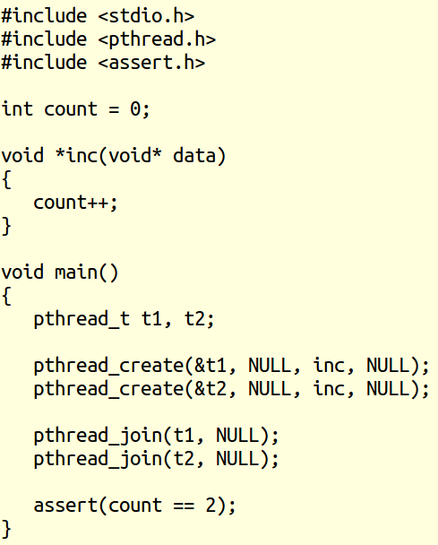
Can count == 2?

Slide 54
Proving/Disproving Assert
Testing
We can run the program several times
But there are so many possible interleavings
We may not cover all possible interleavings
Formal Verification/ Model Checking
Mathematically proves assertion for all possible interleavings
Comes with a counter example if an assertion is violated
Caution: Works well for “small” programs
Often “too many” states to analyze
Runs out of memory

Slide 55
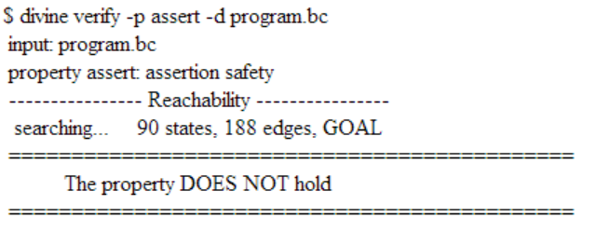
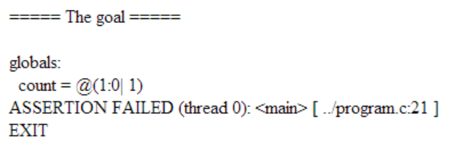
Prove/Disprove assert?
http://divine.fi.muni.cz/try.cgi

Slide 56
Our victim with a buffer overflow
#include <string.h>
void function(char* str)
{
char buffer[80];
strcpy(buffer, str);
}
int main(int argc, char** argv)
{
function(argv[1]);
}
Can we become a root user?

Slide 57
We got the shell as a root!
[~]$ ./victim_eax `cat payload_eax`
#
# whoami
root
#

Slide 58
Agenda
Software Security
W32.Blaster.Worm
Gauging the Threat
Security Concepts
Software Defects
Summary

Slide 59
Software Vulnerabilities
Let’s review: Software vulnerabilities result from security flaws which are software defects that poses a potential security risk.
Software defects can be introduced at all phases of the software development lifecycle and for a
wide-variety of reasons
Let’s examine the Ariane 5 rocket as a case study

Slide 60
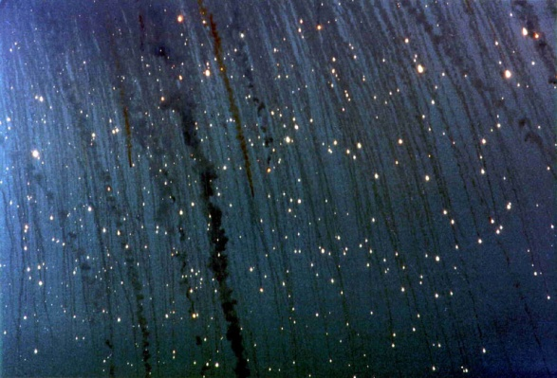
Ariane 5 Launch Failure
On June 4, 1996 an unmanned Ariane 5 rocket launched by the European Space Agency exploded 40 seconds after its lift-off from Kourou, French Guiana.
The rocket was on its first voyage, after a decade of development costing $7 billion.
The destroyed rocket and its cargo were valued at $500 million.

Slide 61
SRI Software Exception
The internal SRI software exception was caused during execution of a data conversion from 64-bit floating point to 16-bit signed integer value.
The floating point number which was converted had a value greater than what could be represented by a 16-bit signed integer resulting in an Operand Error.
The data conversion was not protected from causing an Operand Error, although other conversions of comparable variables in the same place in the code were protected.
The error occurred in a part of the software that only computes meaningful results before lift-off.

Slide 62
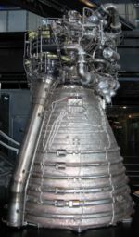
Software Development
Software errors and software vulnerabilities can occur at various phases of the development process and be caused by myriad reasons.
Was the Ariane 5 disaster a
coding error?
process error?
specification error?
reuse error?

Slide 63
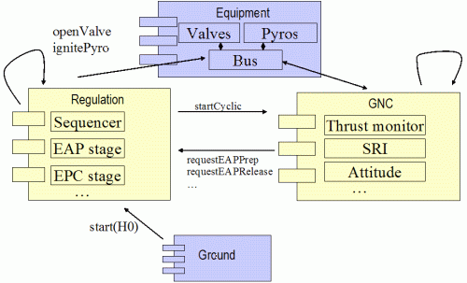
Coding Error?
The floating point number which was converted had a value greater than what could be represented by a 16-bit signed integer resulting in an Operand Error.

Slide 64
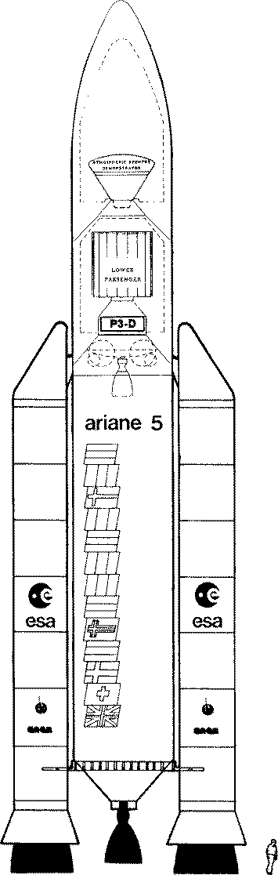
Process Error?
To determine the vulnerability of unprotected code, an analysis was performed on every operation which could give rise to an exception, including an Operand Error.
In particular, the conversion of floating point values to integers was analyzed and operations involving seven variables were at risk of leading to an Operand Error.
This led to protection being added to four of the variables, evidence of which appears in the Ada code.
However, three of the variables were left unprotected.

Slide 65
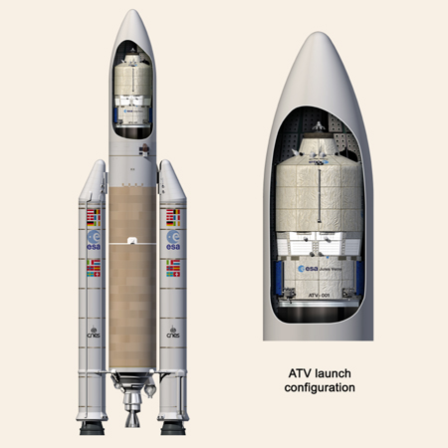
Specification Error?
Although the source of the Operand Error was identified, this in itself did not cause the mission to fail.
The specification of the exception-handling mechanism also contributed to the failure.
In the event of any kind of exception, the system specification stated that the SRI processor should be shut down.
It was the decision to cease the processor operation which finally proved fatal.

Slide 66
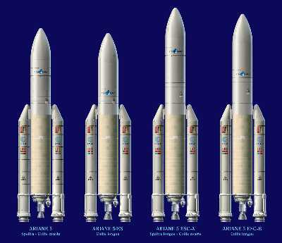
Reuse Error?
The original requirement accounting for the continued operation of the alignment software after lift-off was brought forward more than 10 years ago for the earlier models of Ariane.
This special feature made it possible with the earlier versions of Ariane, to restart the count-down without waiting for normal alignment.
The same requirement does not apply to Ariane 5, which has a different preparation sequence.
It was maintained for commonality reasons, presumably based on the view that, unless proven necessary, it was not wise to make changes in software which worked well on Ariane 4.

Slide 67
Agenda
Software Security
W32.Blaster.Worm
Gauging the Threat
Security Concepts
Software Defects
C

Slide 68
A Brief History of C
Created in the early 1970s as a system implementation language for UNIX
Derived from the typeless language B
The C Programming Language “K&R” published in 1978
ANSI established X3J11 committee in the summer of 1983
X3J11 produced its report at the end of 1989 (C89)
Adopted as ISO/IEC 9899-1990 (C90)
Subsequently replaced by ISO/IEC 9899-1999 (C99)

Slide 69
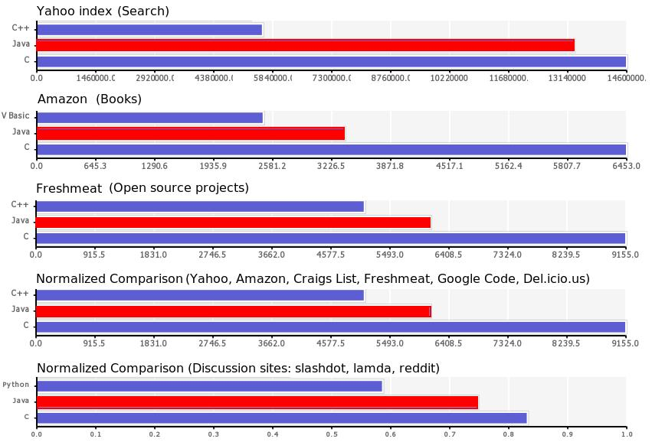
Language Popularity 1
Source: http://www.langpop.com/

Slide 70
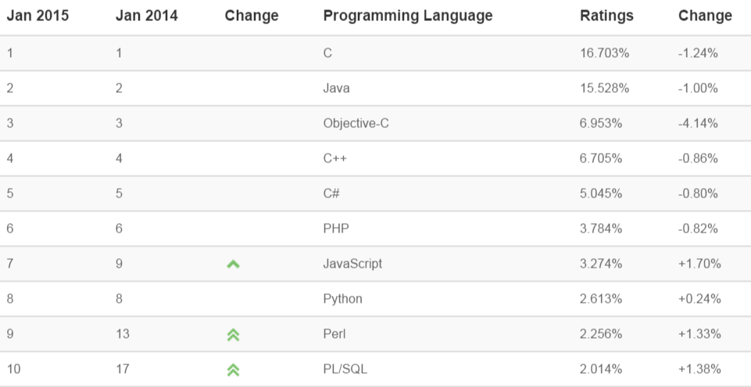
Language Popularity 2
TIOBE Programming Community Index for Jan 2015

Slide 71
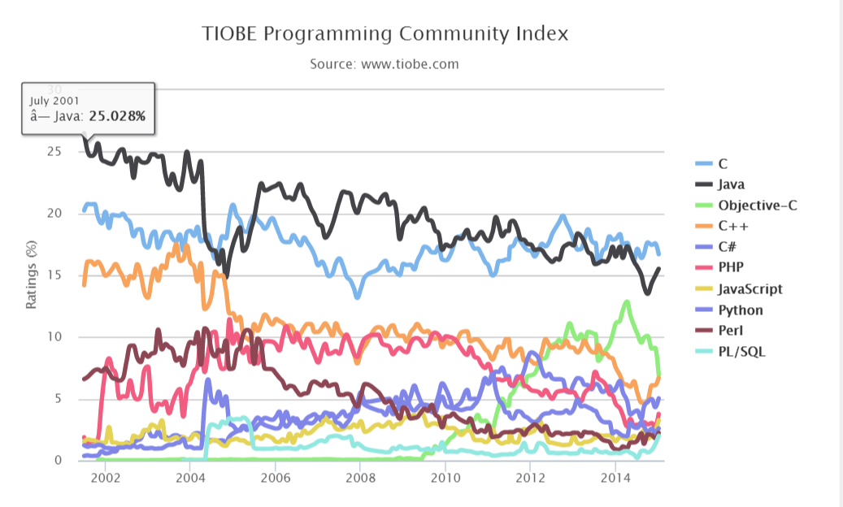
Language Popularity 3 – Jan 2015

Slide 72
What is the Problem with C? 1
The majority of vulnerabilities that have been reported to the SEI CERT/CC have occurred in programs written in C.
Problems arise from an imprecise understanding of the semantics of logical abstractions and how they translate into machine-level instructions.
C is intended to be a lightweight language
Small memory footprint
Built for speed
C compilers are designed to allow you to write the most efficient code possible, assuming that you know what you are doing.

Slide 73
What is the Problem with C? 2
C does not perform array bounds checking and no rigorous type checking
Standard C libraries (e.g., strcpy) have many security vulnerabilities
C looks similar to other procedural languages (e.g., Ada, Pascal)
But these languages have support for integer overflow, array bounds checking, etc.

Slide 74
Legacy Code
A significant amount of legacy C code was created (and passed on) from the early days of Kerningham and Ritchie C (K&R C) before the standardization of the language.
Legacy C code is
at higher risk for security flaws because of the looser compilation standards
harder to secure because of the resulting coding style.

Slide 75
Other Languages: Java
Many security professionals recommend using other languages, such as Java.
While Java does address many of the problems with C, it is still susceptible to implementation-level, as well as design-level, security flaws.
Adopting Java is not always a viable option
Existing investment in C source code
Programming expertise
Development environments

Slide 76
Summary
Everyday software defects cause the majority of software vulnerabilities.
C assume a level of expertise from developers that is not always present.
The result is numerous delivered defects, some of which can lead to vulnerabilities.
Understanding the sources of vulnerabilities and learning to program securely is imperative to protecting the Internet and ourselves from attack.

Slide 77
Acknowledgement
Many slides based on Robert C. Seacord
Robert gave permission to use the slides
Original slides modified to ENPM 691 context

